Slide 1
Practice Questions

Slide 2
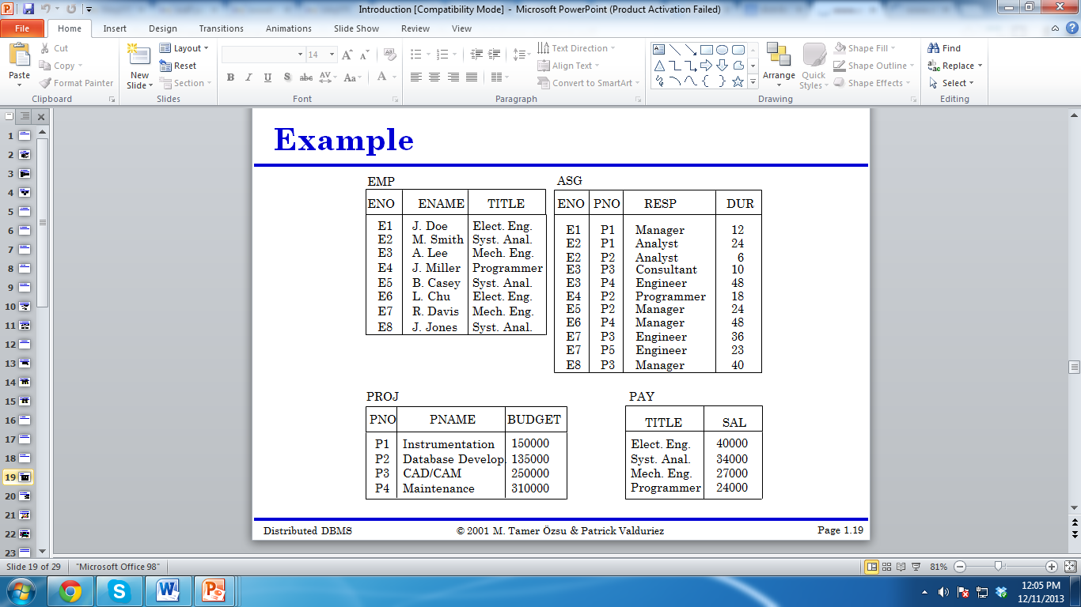
Display the name of employee who are elect engineers

Slide 3
Display the name of employee who earn 25000

Slide 4
Display Eno, ename of employees who work on CAD/CAM
Project and earn 25000

Slide 5
Count the number of employees on project CAD/CAM

Slide 6
Count the number of employees on each project name

Slide 7
Display the name of employee having eno
E1, E2, E3, E4.
Display the name of employees working on project
Instrumentation, maintenance or CAD/CAM

Slide 8
Display the project names and eno who are one of the two
P1, P3, OR the employee title is is programmer . The query
should also list the employees whose salary is great than
Salary of system analyst and mechanical engineer

Slide 9
Display the name of employee who are elect engineers

Slide 10
Writing Queries without data

Slide 11
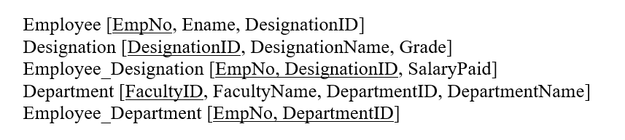
Select Command
Find the designation names whose grades are not yet assigned.

Slide 12
Select Command
Find the designation names whose grades are not yet assigned.
Select Designation
From Designation
Where Grade is NULL

Slide 13
Select Command
How much would be the salary of each employeeID, if the salary he receives is doubled.

Slide 14
Select Command
How much would be the salary of each employee whose ID is above 100, if the salary he receives is doubled.
Select SalaryPaid*2 Double_Salary
From Employee_Designation
Where Employee > 100;

Slide 15
Select Command
Show the names of employees and their designation in the following format. Khurram is working as Assist Prof

Slide 16
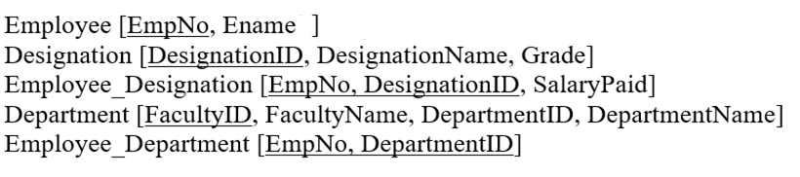
Select Command
Show the Names and designation of the employees who are Lecturers, Assistant Professor or Associate Professor.

Slide 17
Select Command
Show the Names and designation of the employees who are Lecturers, Assistant Professor or Associate Professor.
Select Ename, DesignationName
From Employee E, Designation D, Employee_Designation ED
Where E.EmpNo = ED.EmpNo
AND ED.EmpNo = DesignationID
Where DesignationName IN (‘Lectures’, ‘Assistant Professor’, ‘Associate Professor’);

Slide 18
Select Command
Show the Department names of the employees, whose salaries are between 100,000 and 200,000.

Slide 19
Select Command
Show the Department names of the employees, whose salaries are between 100,000 and 200,000.
Select DepartmentName
From Department D, Employee_Department ED, Employee E, Employee_Designation EmpD, Designation DES
Where D.DepartmentID = ED.DepartmentID
AND ED.EmpNo = E.EmpNo
And E.EmpNo = DES.DesignationID …
AND SalaryPaid Between 100,000 and 200,000;

Slide 20
Select Command
Show the names of the employees whose names start with K.

Slide 21
Select Command
Show the names of the employees whose names start with K.
Select EName
From Employee
Where Ename like ‘K%’

Slide 22
Select Command
Compute the total salary paid by the institute each year.

Slide 23
Select Command
Compute the total salary paid by the institute each year.
Select Sum(SalaryPaid*12)
From Employee_Designation

Slide 24
Select Command
Compute the total salary paid by the each department of the institute along with the department name.

Slide 25
Select Command
Compute the total salary paid by the each department of the institute along with the department name.
Select DepartmentName, Sum(SalaryPaid*12)
From Department D, Employee_Department ED, Employee E, Employee_Designation EMPD
Where D.DepartmentID = ED.EmpNO
AND E. EmpNo = ED.EmpNo
AND Desig.DesignatoinID = E.EmpNo
Group by Department ID / DepartmentName;

Slide 26
Select Command
Generate the list of all employees their respective designations and all designations.

Slide 27
Select Command
Generate the list of all employees (names only) their respective designations and all designations (names only).
Select Ename, DesignationName
From Employee E, Employee_Designation ED, Designation D
Where E. EmpNo = ED.EmpNo (+)
AND ED.DesignatoinID = D.DesignationID (+);

Slide 28
Aggregating Data Using Group Functions
Notes:
Schedule: Timing Topic
35 minutes Lecture
40 minutes Practice
75 minutes Total

Slide 29
Objectives
After completing this lesson, you should be able to do the following:
Identify the available group functions
Describe the use of group functions
Group data using the GROUP BY clause
Include or exclude grouped rows by using the HAVING clause
Notes:
Lesson Aim
This lesson further addresses functions. It focuses on obtaining summary information, such as averages, for groups of rows. It discusses how to group rows in a table into smaller sets and how to specify search criteria for groups of rows.

Slide 30
What Are Group Functions?
Group functions operate on sets of rows to give one result per group.
EMP
DEPTNO SAL
--------- ---------
10 2450
10 5000
10 1300
20 800
20 1100
20 3000
20 3000
20 2975
30 1600
30 2850
30 1250
30 950
30 1500
30 1250
“maximum
salary in
the EMP table”
MAX(SAL)
---------
5000
Notes:
Group Functions
Unlike single-row functions, group functions operate on sets of rows to give one result per group. These sets may be the whole table or the table split into groups.

Slide 31
Types of Group Functions
AVG
COUNT
MAX
MIN
SUM
Notes:
Group Functions (continued)
Each of the functions accepts an argument. The following table identifies the options that you can use in the syntax:

Slide 32
Using Group Functions
SELECT [column,] group_function(column)
FROM table
[WHERE condition]
[GROUP BY column]
[ORDER BY column];
Notes:
Guidelines for Using Group Functions
DISTINCT makes the function consider only nonduplicate values; ALL makes it consider every value including duplicates. The default is ALL and therefore does not need to be specified.
The datatypes for the arguments may be CHAR, VARCHAR2, NUMBER, or DATE where expr is listed.
All group functions except COUNT(*) ignore null values. To substitute a value for null values, use the NVL function.
The Oracle Server implicitly sorts the result set in ascending order when using a GROUP BY clause. To override this default ordering, DESC can be used in an ORDER BY clause.
Class Management Note
Stress the use of DISTINCT and group functions ignoring null values. ALL is the default and is very rarely specified.

Slide 33
Using AVG and SUM Functions
You can use AVG and SUM for numeric data.
SQL> SELECT AVG(sal), MAX(sal),
2 MIN(sal), SUM(sal)
3 FROM emp
4 WHERE job LIKE 'SALES%';
AVG(SAL) MAX(SAL) MIN(SAL) SUM(SAL)
-------- --------- --------- ---------
1400 1600 1250 5600
Notes:
Group Functions
You can use AVG, SUM, MIN, and MAX functions against columns that can store numeric data. The example on the slide displays the average, highest, lowest, and sum of monthly salaries for all salespeople.

Slide 34
Using MIN and MAX Functions
You can use MIN and MAX for any datatype.
SQL> SELECT MIN(hiredate), MAX(hiredate)
2 FROM emp;
MIN(HIRED MAX(HIRED
--------- ---------
17-DEC-80 12-JAN-83
Notes:
Group Functions (continued)
You can use MAX and MIN functions for any datatype. The slide example displays the most junior and most senior employee.
The following example displays the employee name that is first and the employee name that is the last in an alphabetized list of all employees.
Note: AVG, SUM, VARIANCE, and STDDEV functions can be used only with numeric datatypes.
SQL> SELECT MIN(ename), MAX(ename)
2 FROM emp;
MIN(ENAME) MAX(ENAME)
---------- ----------
ADAMS WARD

Slide 35
Using the COUNT Function
COUNT(*) returns the number of rows in a table.
SQL> SELECT COUNT(*)
2 FROM emp
3 WHERE deptno = 30;
COUNT(*)
---------
6
Notes:
The COUNT Function
The COUNT function has two formats:
COUNT(*)
COUNT(expr)
COUNT(*) returns the number of rows in a table, including duplicate rows and rows containing null values in any of the columns. If a WHERE clause is included in the SELECT statement, COUNT(*) returns the number of rows that satisfies the condition in the WHERE clause.
In contrast, COUNT(expr) returns the number of nonnull rows in the column identified by expr.
The slide example displays the number of employees in department 30.
Class Management Note
Demo: l5count1.sql, l5count2.sql
Purpose: To illustrate using the COUNT(*) and COUNT(expr) functions.

Slide 36
Using the COUNT Function
COUNT(expr) returns the number of nonnull rows.
SQL> SELECT COUNT(comm)
2 FROM emp
3 WHERE deptno = 30;
COUNT(COMM)
-----------
4
Notes:
The COUNT Function (continued)
The slide example displays the number of employees in department 30 who can earn a commission. Notice that the result gives the total number of rows to be four because two employees in department 30 cannot earn a commission and contain a null value in the COMM column.
Example
Display the number of departments in the EMP table.
Display the number of distinct departments in the EMP table.
SQL> SELECT COUNT(deptno)
2 FROM emp;
COUNT(DEPTNO)
-------------
14
COUNT(DISTINCT(DEPTNO))
-----------------------
3

Slide 37
Group Functions and Null Values
Group functions ignore null values in the column.
SQL> SELECT AVG(comm)
2 FROM emp;
AVG(COMM)
---------
550
Notes:
Group Functions and Null Values
All group functions except COUNT (*) ignore null values in the column. In the slide example, the average is calculated based only on the rows in the table where a valid value is stored in the COMM column. The average is calculated as total commission being paid to all employees divided by the number of employees receiving commission (4).

Slide 38
Creating Groups of Data
EMP
DEPTNO SAL
--------- ---------
10 2450
10 5000
10 1300
20 800
20 1100
20 3000
20 3000
20 2975
30 1600
30 2850
30 1250
30 950
30 1500
30 1250
2916.6667
“average salary
in EMP table
for each
department”
DEPTNO AVG(SAL)
------- ---------
10 2916.6667
20 2175
30 1566.6667
2175
1566.6667
Notes:
Groups of Data
Until now, all group functions have treated the table as one large group of information. At times, you need to divide the table of information into smaller groups. This can be done by using the GROUP BY clause.

Slide 39
Creating Groups of Data: GROUP BY Clause
SELECT column, group_function(column)
FROM table
[WHERE condition]
[GROUP BY group_by_expression]
[ORDER BY column];
Divide rows in a table into smaller groups by using the GROUP BY clause.
Notes:
The GROUP BY Clause
You can use the GROUP BY clause to divide the rows in a table into groups. You can then use the group functions to return summary information for each group.
In the syntax:
group_by_expression specifies columns whose values determine the basis for grouping rows
Guidelines
If you include a group function in a SELECT clause, you cannot select individual results as well unless the individual column appears in the GROUP BY clause. You will receive an error message if you fail to include the column list.
Using a WHERE clause, you can preexclude rows before dividing them into groups.
You must include the columns in the GROUP BY clause.
You cannot use the column alias in the GROUP BY clause.
By default, rows are sorted by ascending order of the columns included in the GROUP BY list. You can override this by using the ORDER BY clause.

Slide 40
Using the GROUP BY Clause
All columns in the SELECT list that are not in group functions must be in the GROUP BY clause.
SQL> SELECT deptno, AVG(sal)
2 FROM emp
3 GROUP BY deptno;
DEPTNO AVG(SAL)
--------- ---------
10 2916.6667
20 2175
30 1566.6667
Notes:
The GROUP BY Clause (continued)
When using the GROUP BY clause, make sure that all columns in the SELECT list that are not in the group functions are included in the GROUP BY clause. The example on the slide displays the department number and the average salary for each department. Here is how this SELECT statement, containing a GROUP BY clause, is evaluated:
The SELECT clause specifies the columns to be retrieved:
Department number column in the EMP table
The average of all the salaries in the group you specified in the GROUP BY clause
The FROM clause specifies the tables that the database must access: the EMP table.
The WHERE clause specifies the rows to be retrieved. Since there is no WHERE clause, by default all rows are retrieved.
The GROUP BY clause specifies how the rows should be grouped. The rows are being grouped by department number, so the AVG function that is being applied to the salary column will calculate the average salary for each department.

Slide 41
Using the GROUP BY Clause
The GROUP BY column does not have to be in the SELECT list.
SQL> SELECT AVG(sal)
2 FROM emp
3 GROUP BY deptno;
AVG(SAL)
---------
2916.6667
2175
1566.6667
Notes:
The GROUP BY Clause (continued)
The GROUP BY column does not have to be in the SELECT clause. For example, the SELECT statement on the slide displays the average salaries for each department without displaying the respective department numbers. Without the department numbers, however, the results do not look meaningful.
You can use the group function in the ORDER BY clause.
Class Management Note
Demonstrate the query with and without the DEPTNO in the SELECT statement.
DEPTNO AVG(SAL)
---------- ------------
30 1566.6667
20 2175
10 2916.6667

Slide 42
Grouping by More Than One Column
EMP
DEPTNO JOB SAL
--------- --------- ---------
10 MANAGER 2450
10 PRESIDENT 5000
10 CLERK 1300
20 CLERK 800
20 CLERK 1100
20 ANALYST 3000
20 ANALYST 3000
20 MANAGER 2975
30 SALESMAN 1600
30 MANAGER 2850
30 SALESMAN 1250
30 CLERK 950
30 SALESMAN 1500
30 SALESMAN 1250
DEPTNO
--------
10
10
10
20
20
20
30
30
30
JOB SUM(SAL)
--------- ---------
CLERK 1300
MANAGER 2450
PRESIDENT 5000
ANALYST 6000
CLERK 1900
MANAGER 2975
CLERK 950
MANAGER 2850
SALESMAN 5600
“sum salaries in
the EMP table for each job,
grouped by
department”
Notes:
Groups Within Groups
Sometimes there is a need to see results for groups within groups. The slide shows a report that displays the total salary being paid to each job title, within each department.
The EMP table is grouped first by department number, and within that grouping, it is grouped by job title. For example, the two clerks in department 20 are grouped together and a single result (total salary) is produced for all salespeople within the group.
Class Management Note
Demo: l5order1.sql,l5order2.sql
Purpose: To illustrate ordering columns that are grouped by DEPTNO first and ordering columns that are grouped by JOB first.

Slide 43
Using the GROUP BY Clause on Multiple Columns
SQL> SELECT deptno, job, sum(sal)
2 FROM emp
3 GROUP BY deptno, job;
DEPTNO JOB SUM(SAL)
--------- --------- ---------
10 CLERK 1300
10 MANAGER 2450
10 PRESIDENT 5000
20 ANALYST 6000
20 CLERK 1900
...
9 rows selected.
Notes:
Groups Within Groups (continued)
You can return summary results for groups and subgroups by listing more than one GROUP BY column. You can determine the default sort order of the results by the order of the columns in the GROUP BY clause. Here is how the SELECT statement on the slide, containing a GROUP BY clause, is evaluated:
The SELECT clause specifies the column to be retrieved:
Department number in the EMP table
Job title in the EMP table
The sum of all the salaries in the group that you specified in the
GROUP BY clause
The FROM clause specifies the tables that the database must access: the EMP table.
The GROUP BY clause specifies how you must group the rows:
First, the rows are grouped by department number.
Second, within the department number groups, the rows are grouped by job title.
So the SUM function is being applied to the salary column for all job titles within each department number group.

Slide 44
Illegal Queries Using Group Functions
Any column or expression in the SELECT list that is not an aggregate function must be in the GROUP BY clause.
SQL> SELECT deptno, COUNT(ename)
2 FROM emp;
Column missing in the GROUP BY clause
SELECT deptno, COUNT(ename)
*
ERROR at line 1:
ORA-00937: not a single-group group function
Notes:
Illegal Queries Using Group Functions
Whenever you use a mixture of individual items (DEPTNO) and group functions (COUNT) in the same SELECT statement, you must include a GROUP BY clause that specifies the individual items (in this case, DEPTNO). If the GROUP BY clause is missing, then the error message “not a single-group group function” appears and an asterisk (*) points to the offending column. You can correct the error on the slide by adding the GROUP BY clause.
Any column or expression in the SELECT list that is not an aggregate function must be in the GROUP BY clause.
Class Management Note
Demo: l5error.sql
Purpose: To illustrate executing a SELECT statement with no GROUP BY clause.
SQL> SELECT deptno, COUNT(ename)
2 FROM emp
3 GROUP BY deptno;
DEPTNO COUNT(ENAME)
---------- ------------
10 3
20 5
30 6

Slide 45
Illegal Queries Using Group Functions
You cannot use the WHERE clause to restrict groups.
You use the HAVING clause to restrict groups.
SQL> SELECT deptno, AVG(sal)
2 FROM emp
3 WHERE AVG(sal) > 2000
4 GROUP BY deptno;
Cannot use the WHERE clause
to restrict groups
WHERE AVG(sal) > 2000
*
ERROR at line 3:
ORA-00934: group function is not allowed here
Notes:
Illegal Queries Using Group Functions (continued)
The WHERE clause cannot be used to restrict groups. The SELECT statement on the slide results in an error because it uses the WHERE clause to restrict the display of average salaries of those departments that have an average salary greater than $2000.
You can correct the slide error by using the HAVING clause to restrict groups.
SQL> SELECT deptno, AVG(sal)
2 FROM emp
3 GROUP BY deptno
4 HAVING AVG(sal) > 2000;

Slide 46
Excluding Group Results
EMP
DEPTNO SAL
--------- ---------
10 2450
10 5000
10 1300
20 800
20 1100
20 3000
20 3000
20 2975
30 1600
30 2850
30 1250
30 950
30 1500
30 1250
5000
“maximum salary per department
greater than $2900”
DEPTNO MAX(SAL)
--------- ---------
10 5000
20 3000
3000
2850
Notes:
Restricting Group Results
In the same way that you use the WHERE clause to restrict the rows that you select, you use the HAVING clause to restrict groups. To find the maximum salary of each department, but show only the departments that have a maximum salary of more than $2900, you need to do the following:
Find the average salary for each department by grouping by department number.
Restrict the groups to those departments with a maximum salary greater than $2900.

Slide 47
Example
Employee (EID, Ename, DesignationID)
Salary (DesgnID, Salary)
Display ename, the highest, lowest, sum and average salary of all employees
Notes:
The HAVING Clause
You use the HAVING clause to specify which groups are to be displayed. Therefore, you further restrict the groups on the basis of aggregate information.
In the syntax:
group_condition restricts the groups of rows returned to those groups for which the specified condition is TRUE
The Oracle Server performs the following steps when you use the HAVING clause:
Rows are grouped.
The group function is applied to the group.
The groups that match the criteria in the HAVING clause are displayed.
The HAVING clause can precede the GROUP BY clause, but it is recommended that you place the GROUP BY clause first because it is more logical. Groups are formed and group functions are calculated before the HAVING clause is applied to the groups in the SELECT list.

Slide 48
Examples
Employee (EID, Ename, DesignationID)
Design (DesigID, Dname, Grade, SalID)
Salary (SalID, Basic_salary, House_rent, Travelallowance, other allowances)
How much is the average salary of designation (assistant professor in PUCIT)
Notes:
The HAVING Clause
You use the HAVING clause to specify which groups are to be displayed. Therefore, you further restrict the groups on the basis of aggregate information.
In the syntax:
group_condition restricts the groups of rows returned to those groups for which the specified condition is TRUE
The Oracle Server performs the following steps when you use the HAVING clause:
Rows are grouped.
The group function is applied to the group.
The groups that match the criteria in the HAVING clause are displayed.
The HAVING clause can precede the GROUP BY clause, but it is recommended that you place the GROUP BY clause first because it is more logical. Groups are formed and group functions are calculated before the HAVING clause is applied to the groups in the SELECT list.

Slide 49
Examples
Department (DeptID, Salary)
Calculate the maximum salary of each department
Notes:
The HAVING Clause
You use the HAVING clause to specify which groups are to be displayed. Therefore, you further restrict the groups on the basis of aggregate information.
In the syntax:
group_condition restricts the groups of rows returned to those groups for which the specified condition is TRUE
The Oracle Server performs the following steps when you use the HAVING clause:
Rows are grouped.
The group function is applied to the group.
The groups that match the criteria in the HAVING clause are displayed.
The HAVING clause can precede the GROUP BY clause, but it is recommended that you place the GROUP BY clause first because it is more logical. Groups are formed and group functions are calculated before the HAVING clause is applied to the groups in the SELECT list.

Slide 50
Excluding Group Results: HAVING Clause
Use the HAVING clause to restrict groups
Rows are grouped.
The group function is applied.
Groups matching the HAVING clause are displayed.
SELECT column, group_function
FROM table
[WHERE condition]
[GROUP BY group_by_expression]
[HAVING group_condition]
[ORDER BY column];
Notes:
The HAVING Clause
You use the HAVING clause to specify which groups are to be displayed. Therefore, you further restrict the groups on the basis of aggregate information.
In the syntax:
group_condition restricts the groups of rows returned to those groups for which the specified condition is TRUE
The Oracle Server performs the following steps when you use the HAVING clause:
Rows are grouped.
The group function is applied to the group.
The groups that match the criteria in the HAVING clause are displayed.
The HAVING clause can precede the GROUP BY clause, but it is recommended that you place the GROUP BY clause first because it is more logical. Groups are formed and group functions are calculated before the HAVING clause is applied to the groups in the SELECT list.

Slide 51
Using the HAVING Clause
SQL> SELECT deptno, max(sal)
2 FROM emp
3 GROUP BY deptno
4 HAVING max(sal)>2900;
DEPTNO MAX(SAL)
--------- ---------
10 5000
20 3000
Notes:
The HAVING Clause (continued)
The slide example displays department numbers and maximum salary for those departments whose maximum salary is greater than $2900.
You can use the GROUP BY clause without using a group function in the SELECT list.
If you restrict rows based on the result of a group function, you must have a GROUP BY clause as well as the HAVING clause.
The following example displays the department numbers and average salary for those departments whose maximum salary is greater than $2900:
SQL> SELECT deptno, AVG(sal)
2 FROM emp
3 GROUP BY deptno
4 HAVING MAX(sal) > 2900;

Slide 52
Having Clause
SELECT column_name, aggregate_function(column_name) FROM table_name WHERE column_name operator value GROUP BY column_name HAVING aggregate_function(column_name) operator value;

Slide 53
Using the HAVING Clause
SQL> SELECT job, SUM(sal) PAYROLL
2 FROM emp
3 WHERE job NOT LIKE 'SALES%'
4 GROUP BY job
5 HAVING SUM(sal)>5000
6 ORDER BY SUM(sal);
JOB PAYROLL
--------- ---------
ANALYST 6000
MANAGER 8275
Notes:
The HAVING Clause (continued)
The slide example displays the job title and total monthly salary for each job title with a total payroll exceeding $5000. The example excludes salespeople and sorts the list by the total monthly salary.
Class Management Note
Demo: l5job1.sql, l5job2.sql
Purpose: To illustrate using a WHERE clause to restrict rows by JOB and using a HAVING clause to restrict groups by SUM(SAL).

Slide 54
Nesting Group Functions
Display the maximum average salary.
SQL> SELECT max(avg(sal))
2 FROM emp
3 GROUP BY deptno;
MAX(AVG(SAL))
-------------
2916.6667
Notes:
Nesting Group Functions
Group functions can be nested to a depth of two. The slide example displays the maximum average salary.

Slide 55
Summary
SELECT column, group_function(column)
FROM table
[WHERE condition]
[GROUP BY group_by_expression]
[HAVING group_condition]
[ORDER BY column];
Order of evaluation of the clauses:
WHERE clause
GROUP BY clause
HAVING clause
Notes:
Summary
Seven group functions are available in SQL:
AVG
COUNT
MAX
MIN
SUM
STDDEV
VARIANCE
You can create subgroups by using the GROUP BY clause. Groups can be excluded using the HAVING clause.
Place the HAVING and GROUP BY clauses after the WHERE clause in a statement. Place the ORDER BY clause last.
The Oracle Server evaluates the clauses in the following order:
If the statement contains a WHERE clause, the server establishes the candidate rows.
The server identifies the groups specified in the GROUP BY clause.
The HAVING clause further restricts result groups that do not meet the group criteria in the HAVING clause.

Slide 56
Practice Overview
Showing different queries that use group functions
Grouping by rows to achieve more than one result
Excluding groups by using the HAVING clause
Notes:
Practice Overview
At the end of this practice, you should be familiar with using group functions and selecting groups of data.
Paper-Based Questions
For questions 1–3, circle either True or False.
Note: Column aliases are used for the queries.
Class Management Note
Hint for Practice #7: Advise the students to think about the MGR column in EMP when determining the number of managers, rather than the JOB column.

